Slide 1
Snowflake – Data Pipelines
Continuous Data Loading - Snow Pipe
Data Tracking - Slowly Changing Dimension (SCD) – Change Data Tracking -- Streams
Stream object records the delta of change data capture (CDC) information for a table
All DMLs are Tracked using Streams
A stream allows querying and consuming a set to a table, at the row level, between two transactional points of time of changes
Tasks - Recurring
Task object defines a recurring schedule for executing a SQL statement, including statements that call stored procedures
Tasks may be used table streams to provide a convenient way to continuously process table DML delta
If a Task is setup on a Table for scheduled to run, it can verify whether a stream contains change data for a table (using SYSTEM$STREAM_HAS_DATA) and either consume the change data or skip the current run if no change data exists.

Slide 2
Snowflake – Data Pipelines
What are the types of SCD?
Type 0 – Fixed Dimension
No changes allowed, dimension never changes
Type 1 – No History
Update record directly, there is no record of historical values, only current state
Type 2 – Row Versioning
Track changes as version records with current flag & active dates and other metadata
Type 3 – Previous Value column
Track change to a specific attribute, add a column to show the previous value, which is updated as further changes occur
Type 4 – History Table
Show current value in dimension table but track all changes in separate table
Type 6 – Hybrid SCD
Utilize techniques from SCD Types 1, 2 and 3 to track change

Slide 3
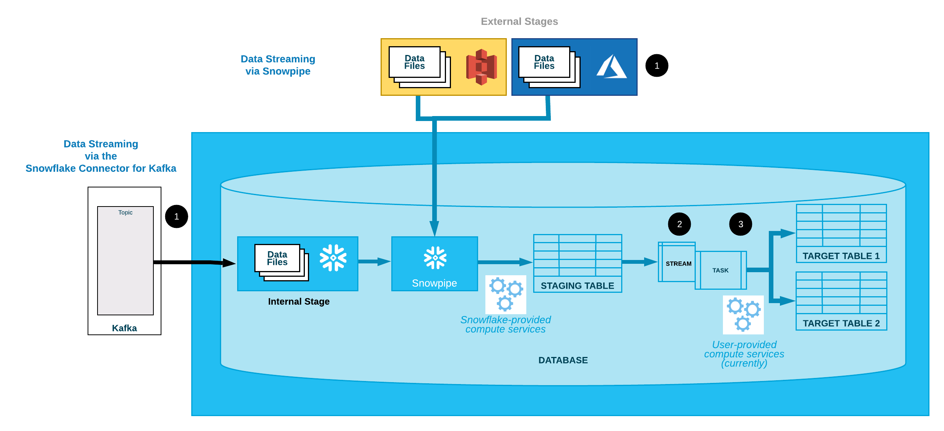
Snowflake – Data Pipelines
Continuous Data Loading - Workflow
Snowpipe Continuously loads micro-batches of data from an external stage location (i.e. AWS S3, Google Cloud Storage, or Microsoft Azure) into a staging table.
One or more stream objects capture change data and make it available to query.
One or more tasks execute SQL statements (which could call stored procedures) to transform the change data and move the optimized data sets into destination tables for analysis. Each time this transformation process runs, it selects the change data in the stream to perform DML operations on the destination tables and then consumes the change data when the transaction is committed.

Slide 4
Snowflake – Data Pipe Lines
Streams
Stream logically takes an initial snapshot of every row in the source table by initializing a point in time (offset) as the current transactional version of the table
Stream itself does not contain any table data. A stream only stores the offset for the source table and returns CDC (Change Data Capture) records by leveraging the versioning history for the source table
Table Versioning –
A stream maintains a point of time into the transactional versioned timeline of the source table, called an offset, which starts at the transactional point when the stream contents were last consumed using a DML statement
The stream maintains only the delta of the changes; if multiple DML statements change a row, the stream contains only the latest action taken on that row
Repeatable Read Isolation –
Multiple SQL statements within a transaction see the same set of records in a stream. This differs from the read committed mode supported for tables
Depends on AUTO COMMIT Parameter

Slide 5
Snowflake – Data Pipe Lines
Streams
This differs from the read committed mode supported for tables, in which statements see any changes made by previous statements executed within the same transaction, even though those changes are not yet committed.
The current offset for a stream can be determined by querying the SYSTEM$STREAM_GET_TABLE_TIMESTAMP function.
A DML statement that selects from a stream consumes all of the change data in the stream as long as the transaction commits successfully.
To ensure multiple statements access the same change records in the stream, surround them with an explicit transaction statement (BEGIN .. COMMIT) which locks the stream
DML updates to the source table in parallel transactions are tracked by the change tracking system but do not update the stream until the explicit transaction statement is committed and the existing change data is consumed
Stream Columns –
METADATA$ACTION
METADATA$ISUPDATE
METADATA$ROW_ID
Data Retention Period and Staleness
If a stream is created on a table, the data retention period is 14 days
Additional Storage Charges are applied

Slide 6
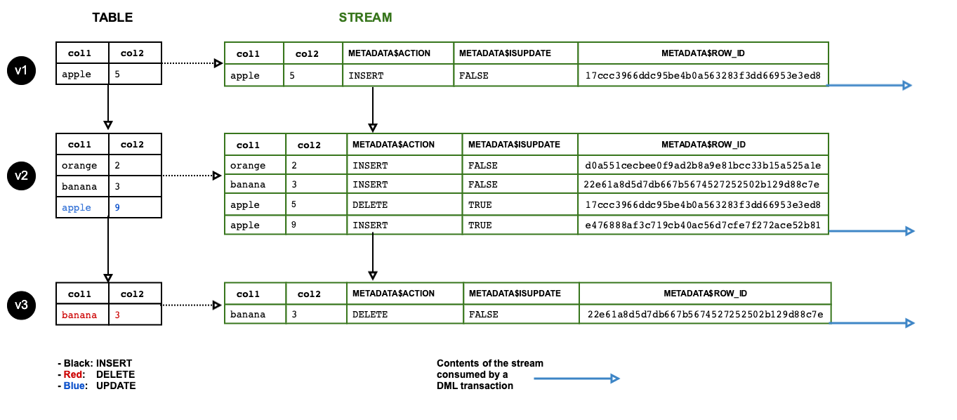
Snowflake – Data Pipe Lines
Data Flow

Slide 7
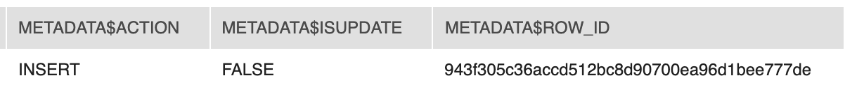
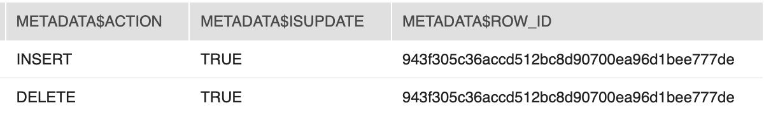
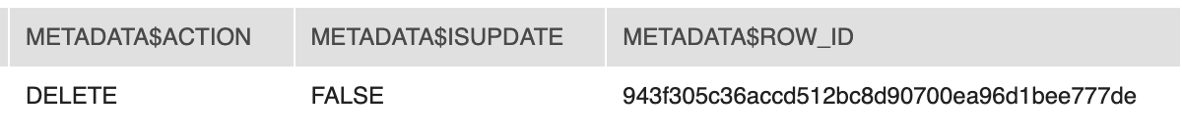
Snowflake – Data Pipe Lines
Insert
Update
Delete

Slide 8
Snowflake – Data Pipe Lines
Streams DDL
Create Stream
Alter Stream
Drop Stream
Describe Stream
Show Stream
system$stream_has_data – Select system$stream_has_data(<Stream Name>);
Script
CREATE [ OR REPLACE ] STREAM [IF NOT EXISTS]
<name>
[ COPY GRANTS ]
[ COMMENT = '<string_literal>' ]
ON TABLE <table_name>
[ { AT | BEFORE } { TIMESTAMP => <timestamp> | OFFSET => <time_difference> | STATEMENT => <id> } ]
Examples :
create stream mystream on table mytable;
Using Time Travel with the Source Table:
--Create a stream on the mytable table as it existed exactly at the date and time of the specified timestamp:
create stream mystream on table mytable at (timestamp => to_timestamp_tz('02/02/2019 01:02:03', 'mm/dd/yyyy hh24:mi:ss'));
--Create a stream on the mytable table as it existed 5 minutes ago:
Create stream mystream on table mytable at(offset => -60*5);
--Create a stream on the mytable table including transactions up to, but not including any changes made by the specified transaction:
create stream mystream on table mytable before(statement => '8e5d0ca9-005e-44e6-b858-a8f5b37c5726');

Slide 9
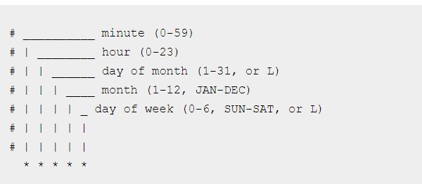
Snowflake – Tasks
Tasks
Run Based on Frequency Configuration in the Definition
Execute Single DML Statement or Procedure
Can be combined with streams for ELT workflow
Generate periodic reports by inserting or merging rows into a report table
One-hour limit on a single run of a task (Max One Hour Running SQL or Proc)
Task Timed out or Exceeded the Schedule Window – Check for Warehouse or Performance
Tasks Must me resumed after Creation
Task Scheduling – By Minute or Using Cron Job Notation

Slide 10
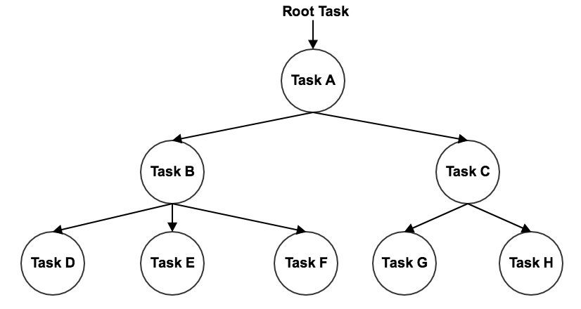
Snowflake – Tasks
Tasks DDL
Create Task
Alter Task
Drop Task
Describe Task
Show Tasks
SYSTEM$CURRENT_USER_TASK_NAME
TASK_HISTORY
TASK_DEPENDENTS
SYSTEM$TASK_DEPENDENTS_ENABLE
Tasks in Hierarchy
Root Task Must Have a Schedule
A Task is limited to 1 Predecessor Task
Max 100 Child Tasks – Task B

Slide 11
Snowflake – Tasks
Tasks
CREATE [ OR REPLACE ] TASK [ IF NOT EXISTS ] <name>
WAREHOUSE = <string>
[ SCHEDULE = { <number> MINUTE | USING CRON <expr> <time_zone> } | AFTER <string> ]
[ <session_parameter> = <value> [ , <session_parameter> = <value> ... ] ]
[ COPY GRANTS ]
[ COMMENT = '<string_literal>' ]
[ WHEN <boolean_expr> ]
AS
<sql>Task Scheduling
Examples :
-- Create a task that Inserts data After Every Hour
insert into my_customer values ();
-- Insert Data into Table Every 1 Hour Starting from 9 AM and Ending 5 PM Sundays (America/Los Angeles time zone)
CREATE OR REPLACE TASK mytask_hour
WAREHOUSE = mpeters_wh
SCHEDULE = 'USING CRON 0 9-17 * * SUN America/Los_Angeles'
TIMESTAMP_INPUT_FORMAT = 'YYYY-MM-DD HH24'
AS
INSERT INTO mytable(ts) VALUES(CURRENT_TIMESTAMP);

Slide 12
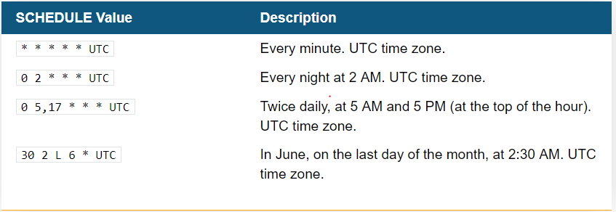
Snowflake – Tasks
Tasks
Examples : In UTC Time Zone
-- Checking If the Stream Has Data Every 5 Mins and Insert
CREATE OR REPLACE TASK mytask1
WAREHOUSE = mywh
SCHEDULE = '5 minute'
WHEN
SYSTEM$STREAM_HAS_DATA('MYSTREAM')
AS
INSERT INTO mytable1(id,name) SELECT id, name FROM mystream WHERE METADATA$ACTION = 'INSERT';

Slide 13
Snowflake – Tasks
Tasks
More Examples :
-- Tree Of Tasks
CREATE OR REPLACE TASK mytask2
WAREHOUSE = mywh
AFTER mytask1
AS
INSERT INTO mytable2(id,name) SELECT id, name FROM mytable1;
-- Create a task that calls the stored procedure every hour
create or replace task mytask1
warehouse = mywh
schedule = '60 minute'
as
call my_unload_sp();
system$task_dependents_enable
select system$task_dependents_enable('mydb.myschema.mytask');

Slide 14
Snowflake – Tasks
Task_History
--Retrieve the 100 most recent task executions (completed, still running, or scheduled in the future) in the current database and schema:
select *
from table(information_schema.task_history())
order by scheduled_time;
--Retrieve the execution history for tasks in the current database and schema within a specified 30 minute block of time within the past 7 days:
select *
from table(information_schema.task_history(
scheduled_time_range_start=>to_timestamp_ltz('2018-11-9 12:00:00.000 -0700'),
scheduled_time_range_end=>to_timestamp_ltz('2018-11-9 12:30:00.000 -0700')));
--Retrieve the 10 most recent executions of a specified task (completed, still running, or scheduled in the future) scheduled within the last hour:
select *
from table(information_schema.task_history(
scheduled_time_range_start=>dateadd('hour',-1,current_timestamp()),
result_limit => 10,
task_name=>'MYTASK’));
--Retrieve only tasks that are completed or still running
select *
from table(information_schema.task_history())
Where query_id is not null;

